Slide 1

C# Coding Guidelines and Best Practices
Logesh Palani
@logeshpalani98

Slide 2
Why Clean Code?
This is not a style guide. It's a guide to producing readable, reusable, and refactorable Software Engineering in general. Just enforcing developers to follow the rules or standards
Notes:
Makes you better developer

Slide 3
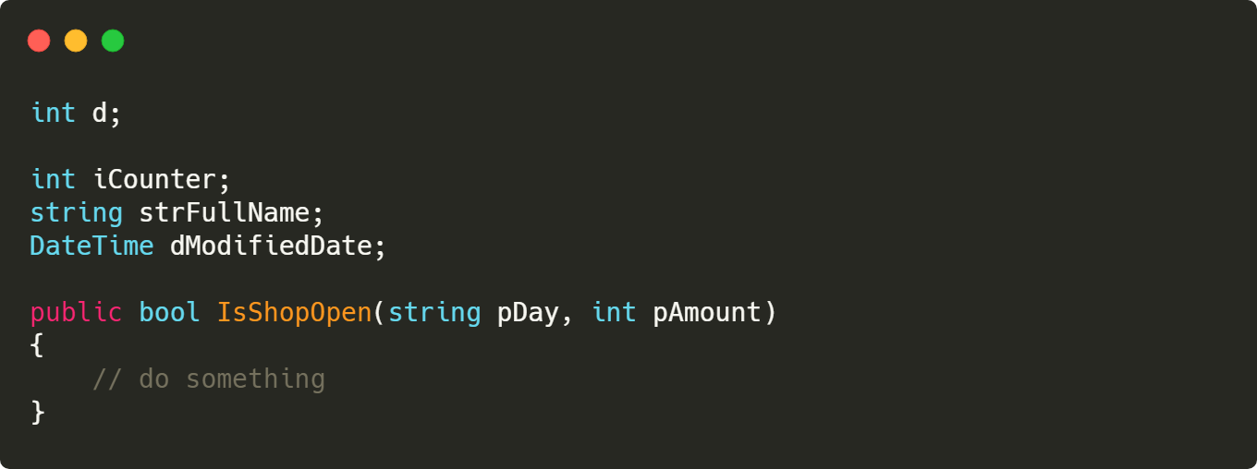
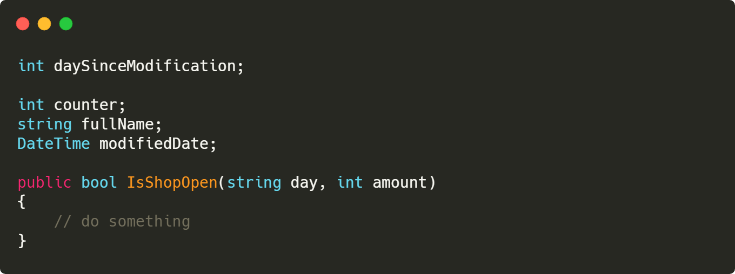
Bad:
Naming Convention
Bad:
Good:
Notes:
Makes you better developer

Slide 4
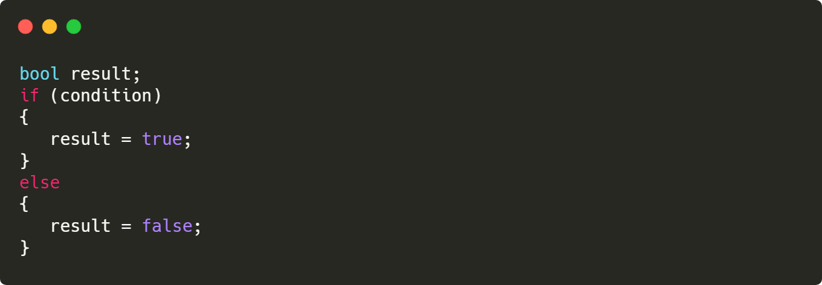

Bad:
Condition Statement
Bad:
Good:
Notes:
Makes you better developer

Slide 5
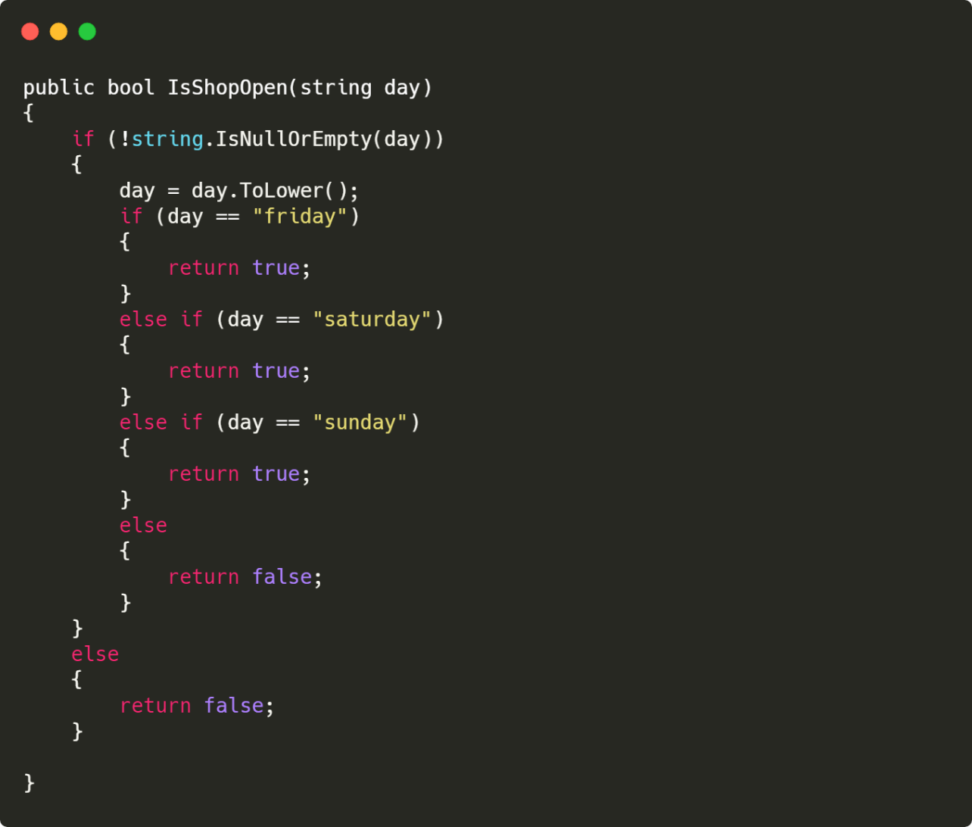
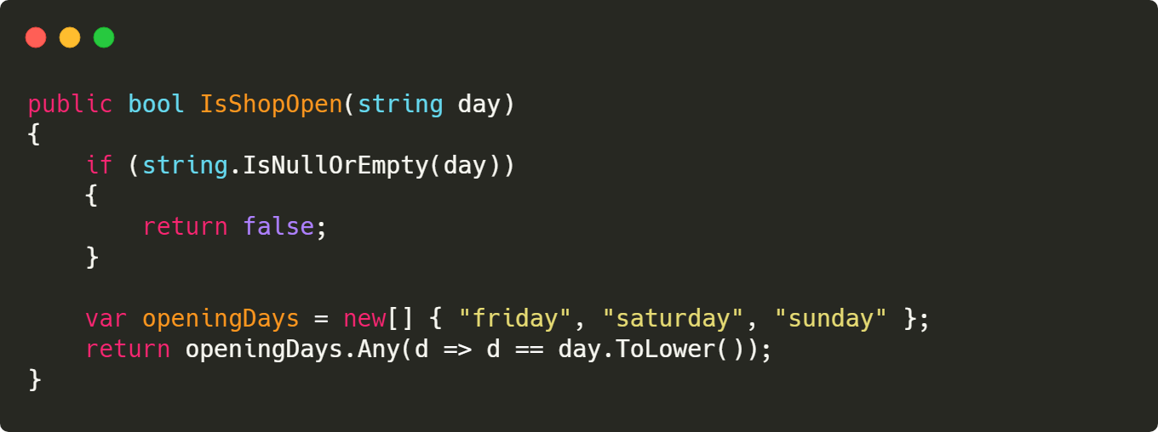
Condition Statement
Bad:
Good:
Notes:
Makes you better developer

Slide 6
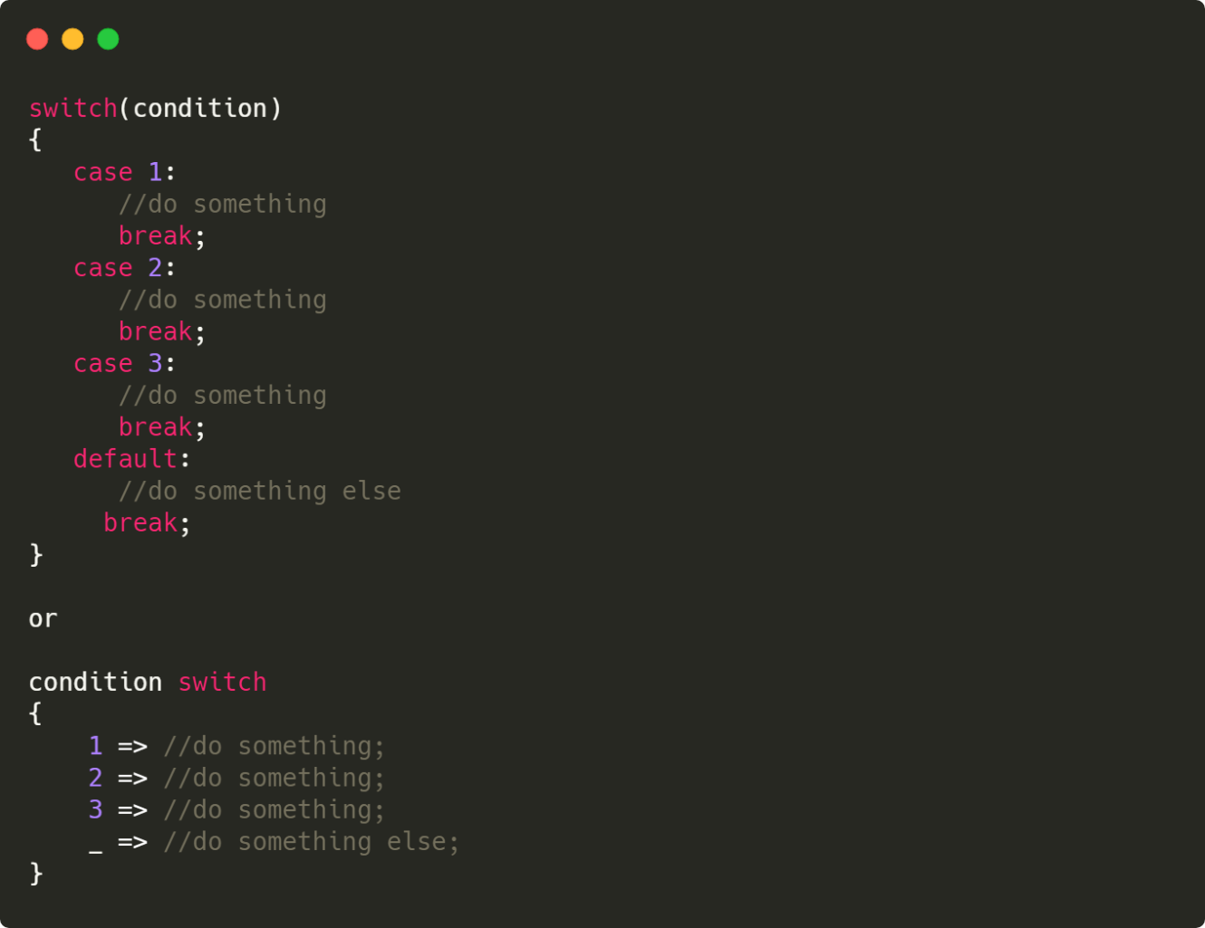
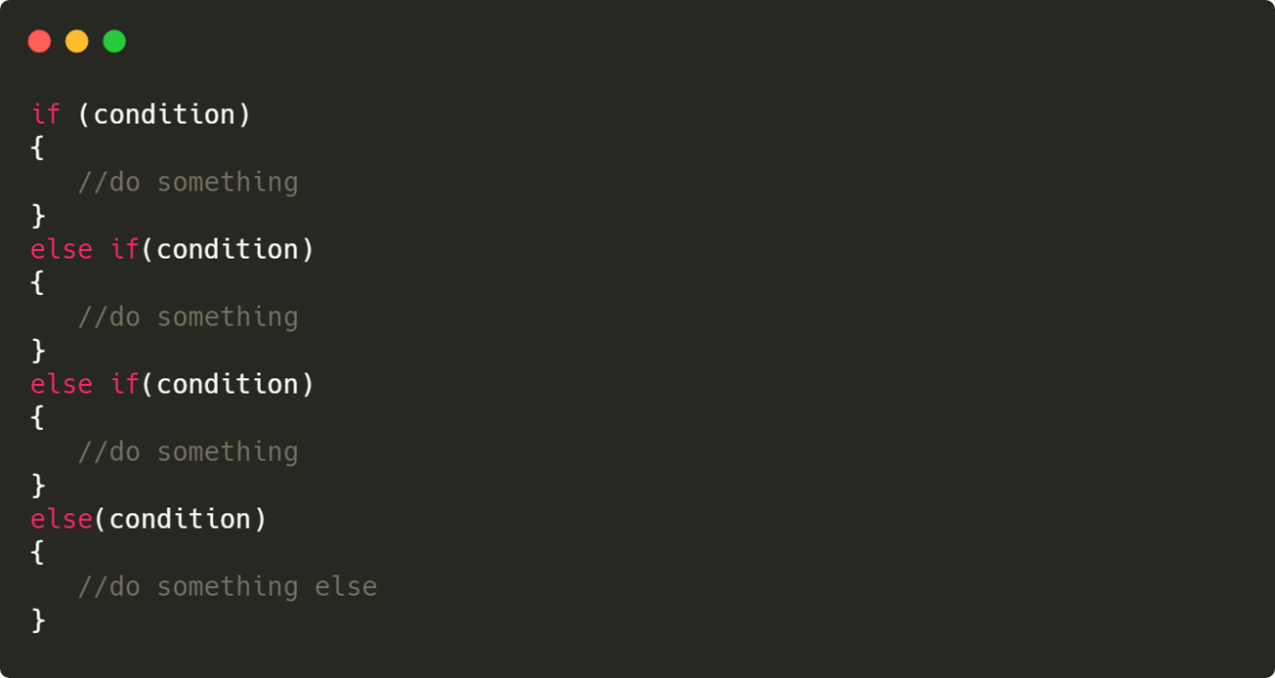
Condition Statement
Bad:
Good:
Notes:
Makes you better developer

Slide 7
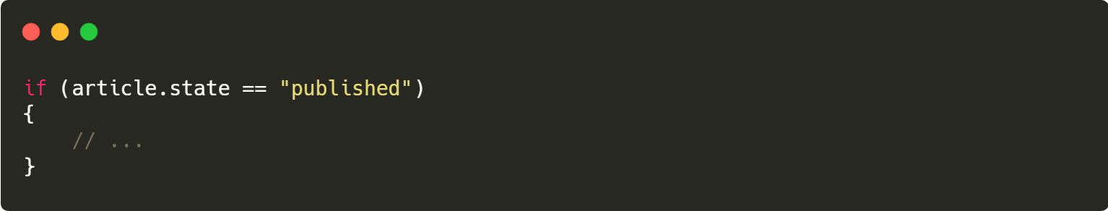
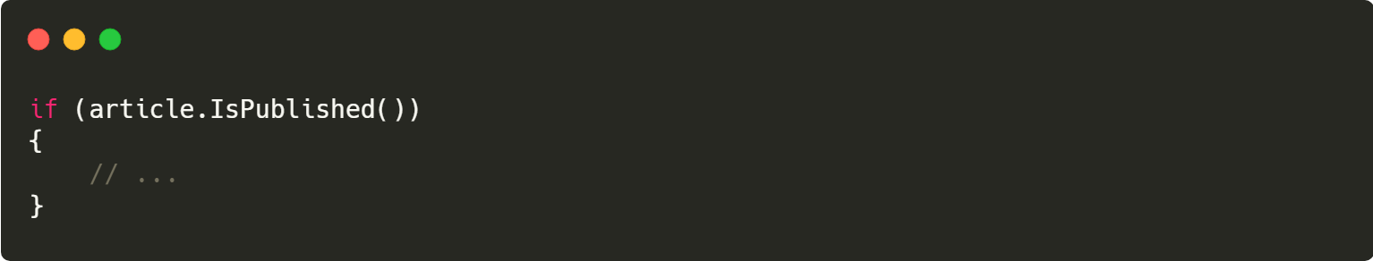
Condition
Bad:
Good:
Notes:
Makes you better developer

Slide 8
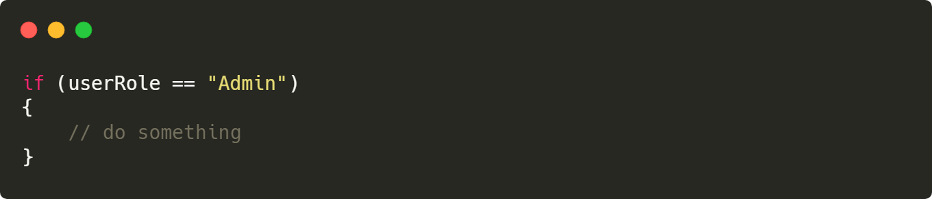
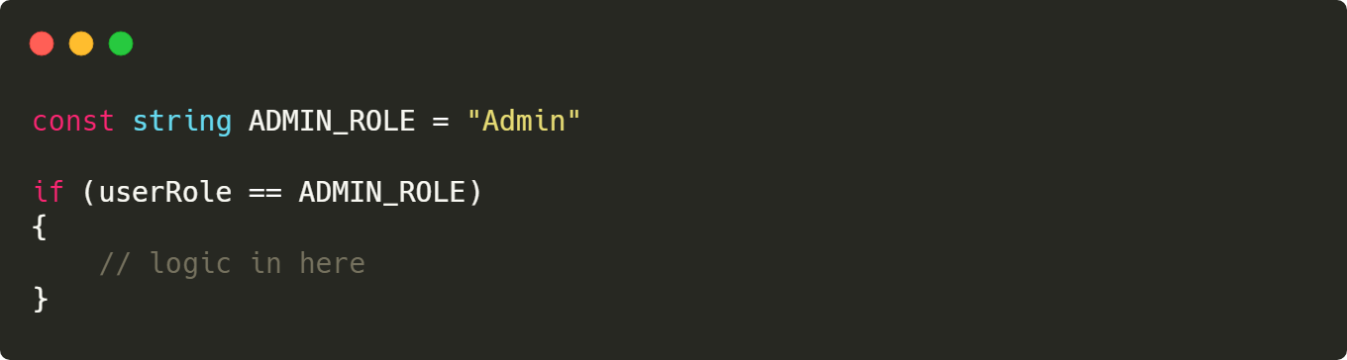
Bad:
Magic string
Bad:
Good:
Notes:
Makes you better developer

Slide 9
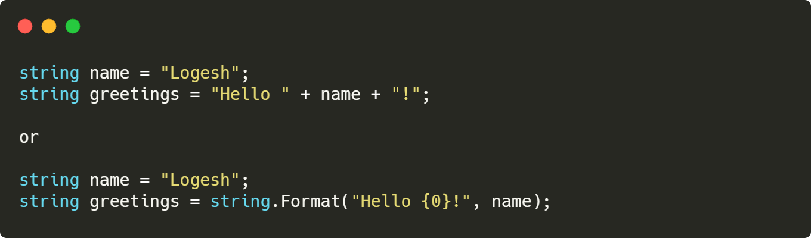
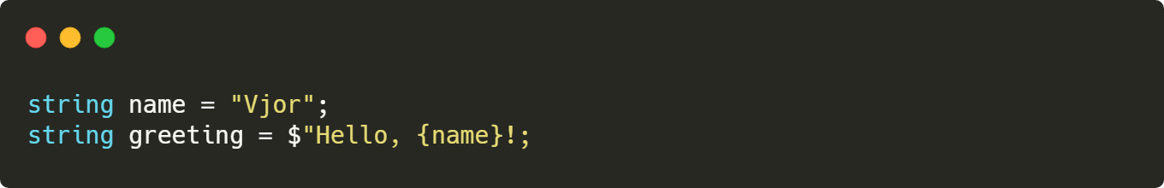
String
Bad:
Good:
Notes:
Makes you better developer

Slide 10
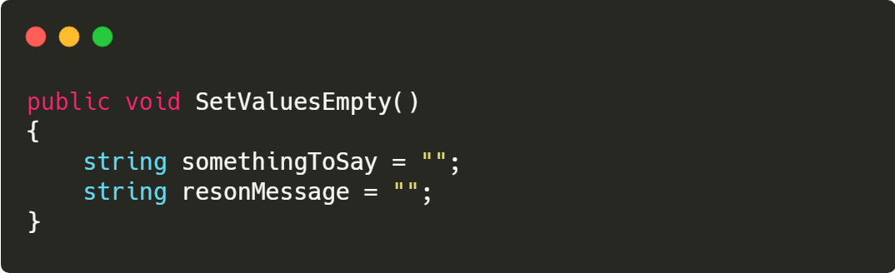
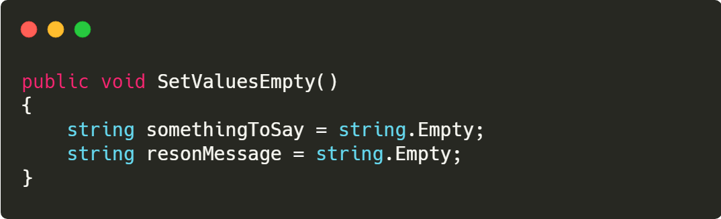
String
Bad:
Good:
Notes:
Makes you better developer

Slide 11
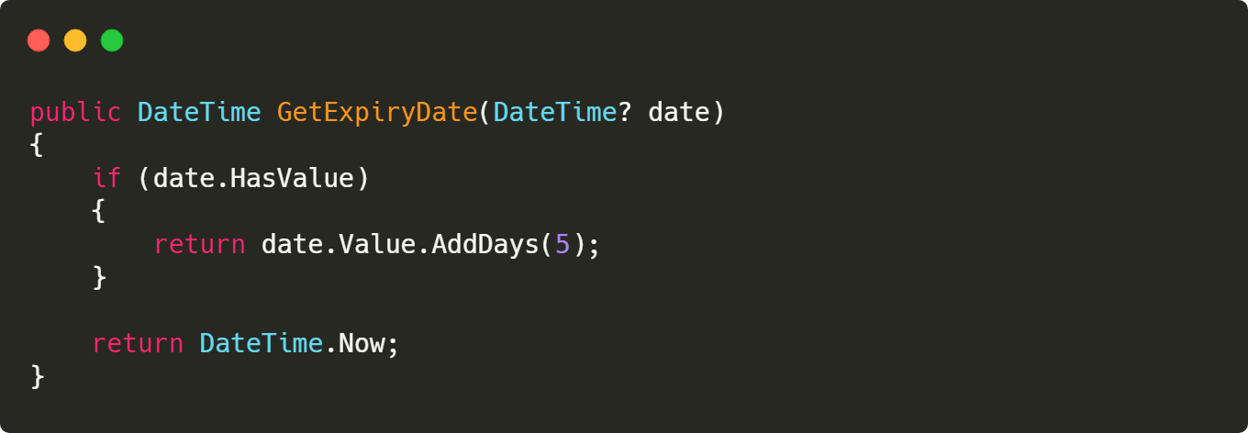
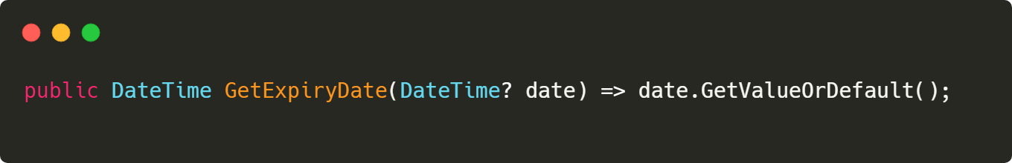
Bad:
Lambda expression
Bad:
Good:
Notes:
Makes you better developer

Slide 12
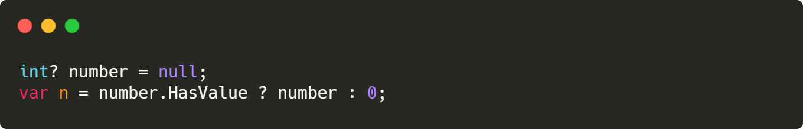
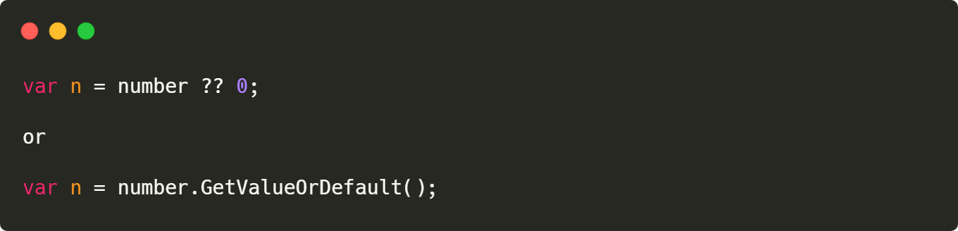
Nullable
Bad:
Good:
Notes:
Makes you better developer

Slide 13
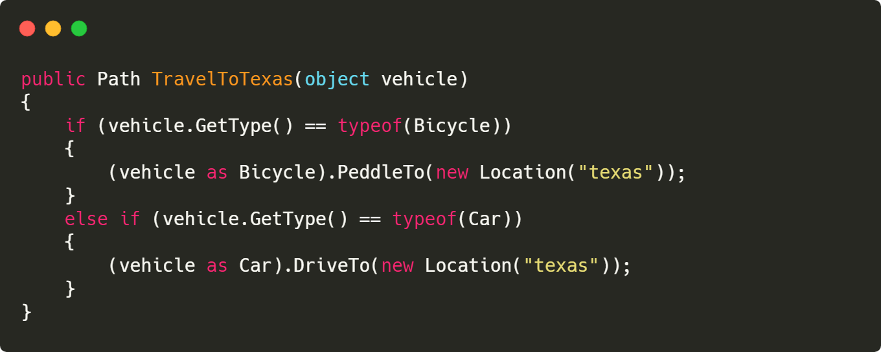
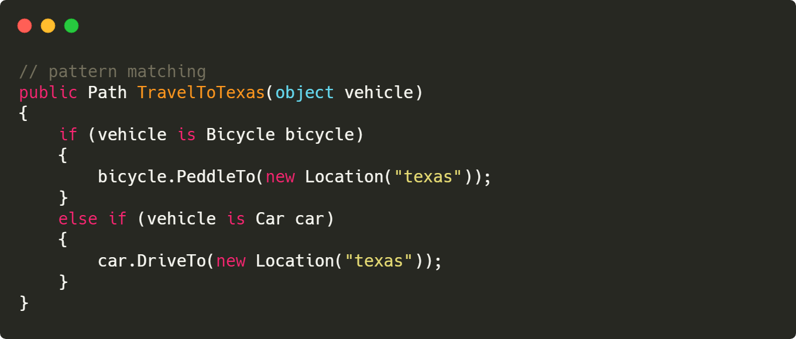
Type Checking
Bad:
Good:

Slide 14
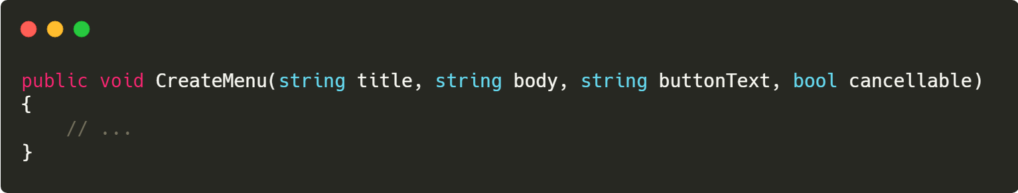
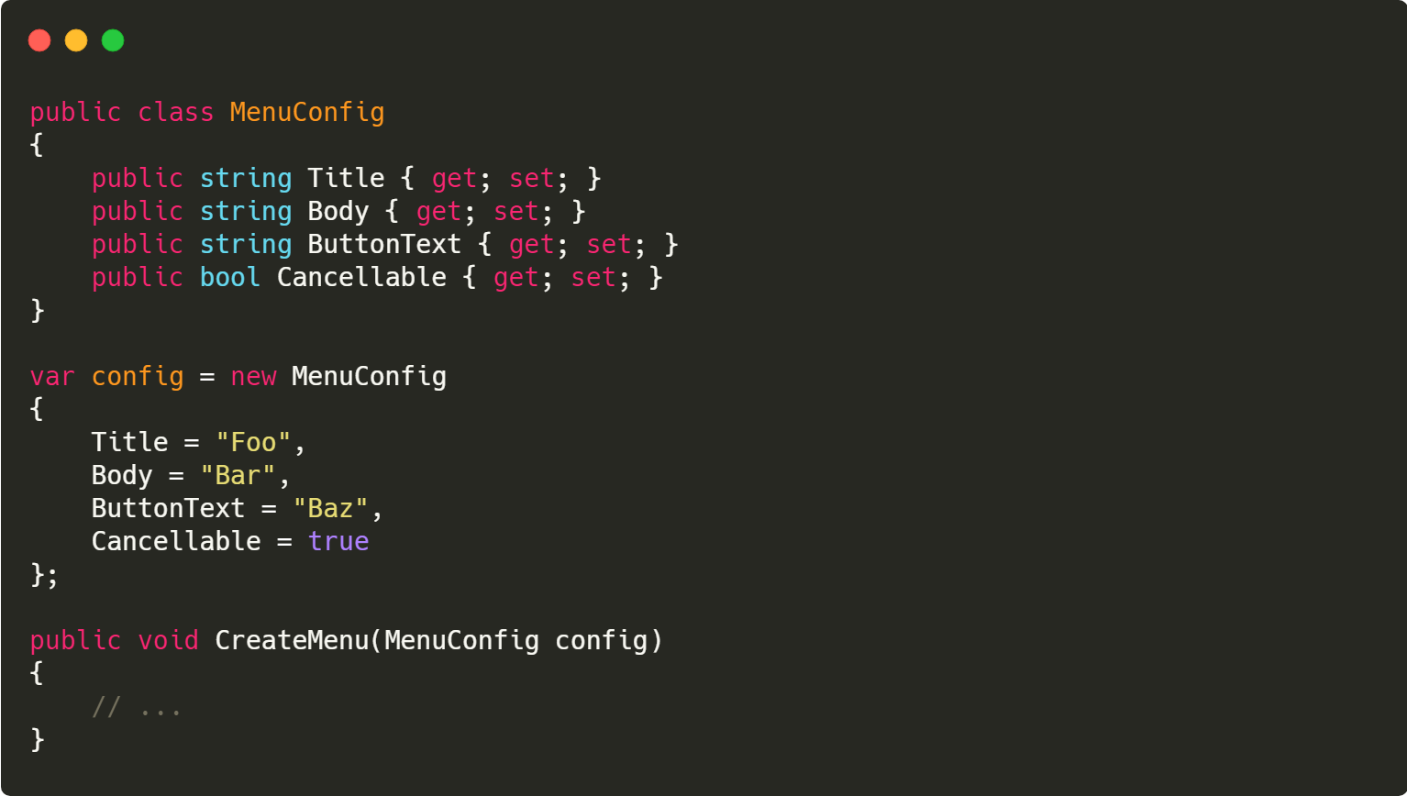
More Parameters
Bad:
Good:

Slide 15
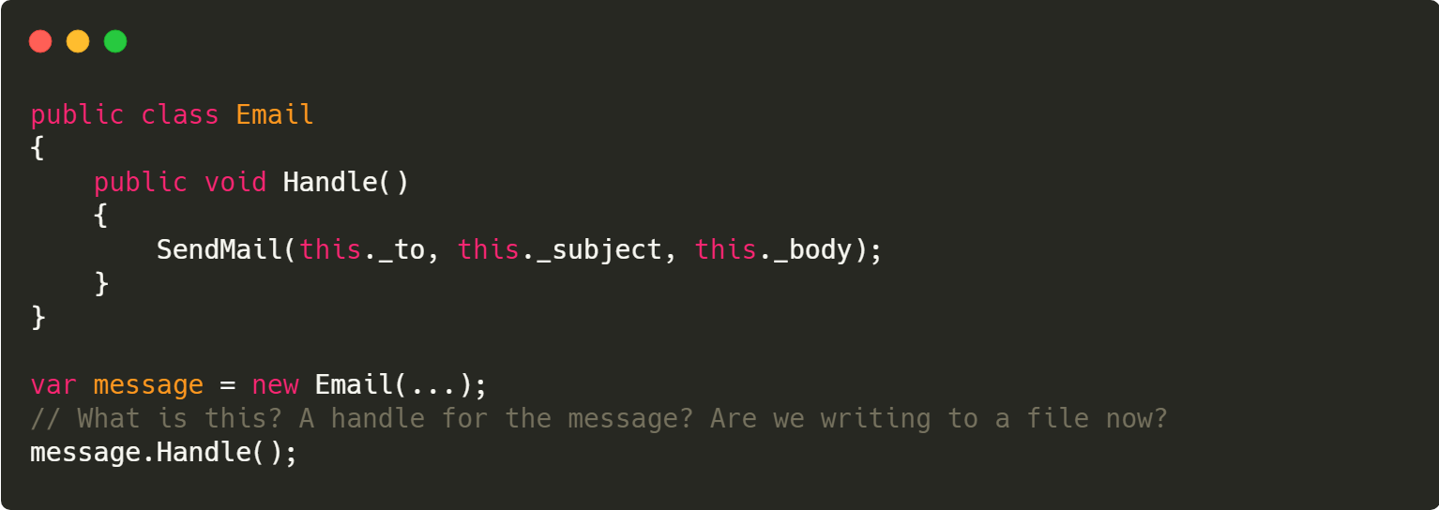
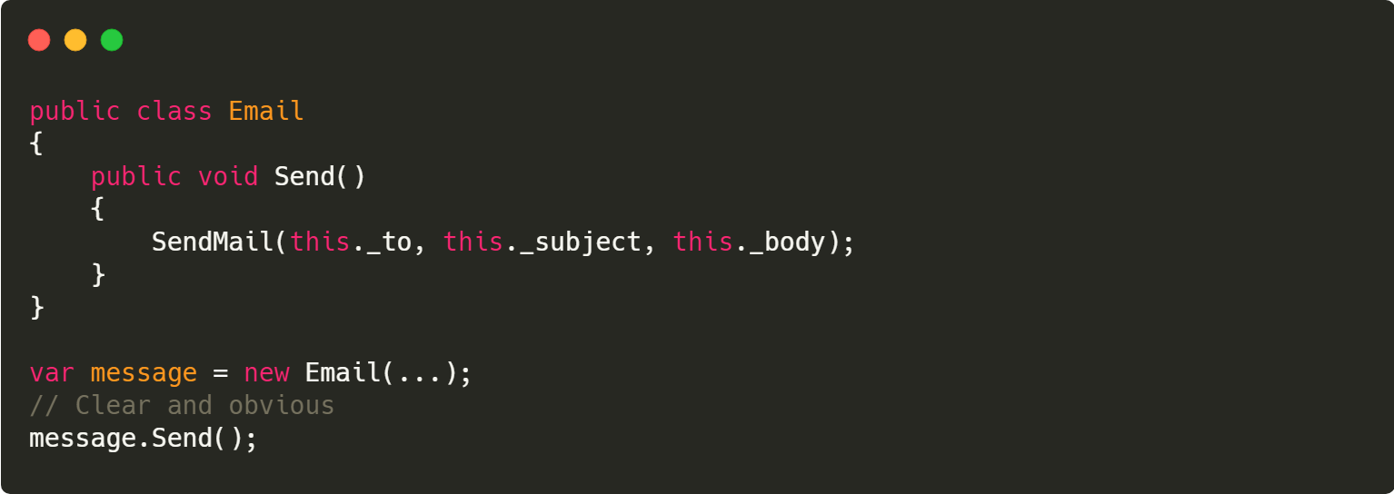
Function should say what they do
Bad:
Good:
Notes:
Testablity

Slide 16
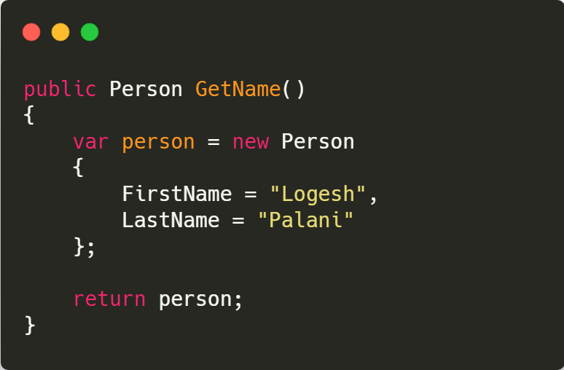
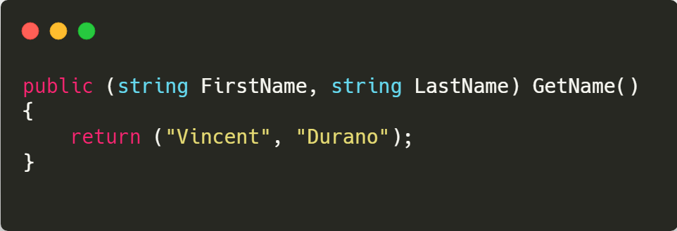
Tuple
Bad:
Good:
Notes:
Testablity

Slide 17
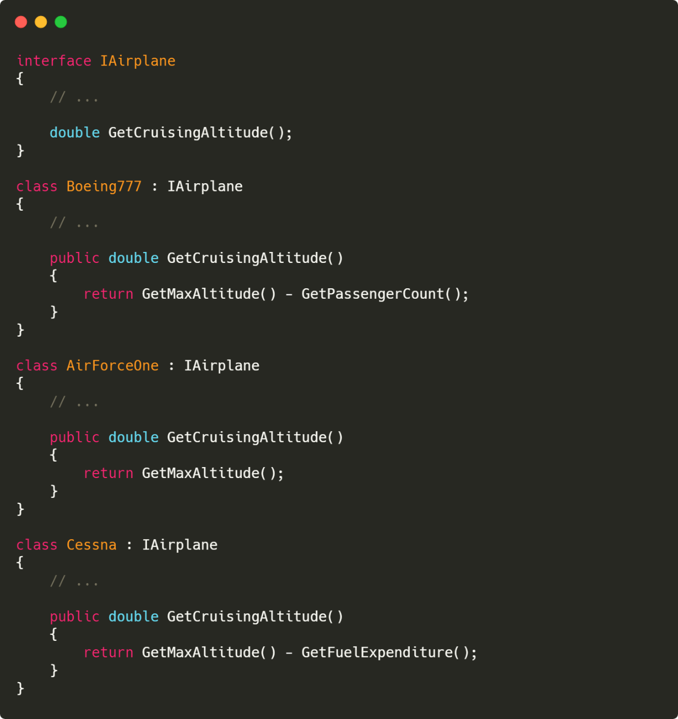
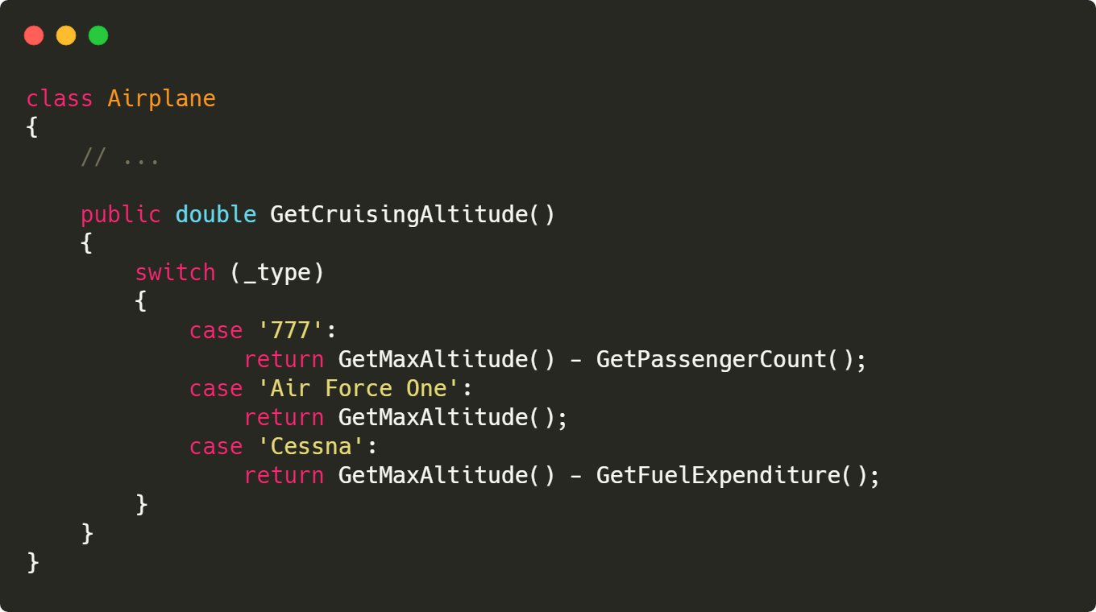
Polymorphism
Bad:
Good:
Notes:
Polymorphism
Class or Function contains if statement, It will do multiple task our clean code concept says the function or class must to one task just remember it
OCP Principle

Slide 18
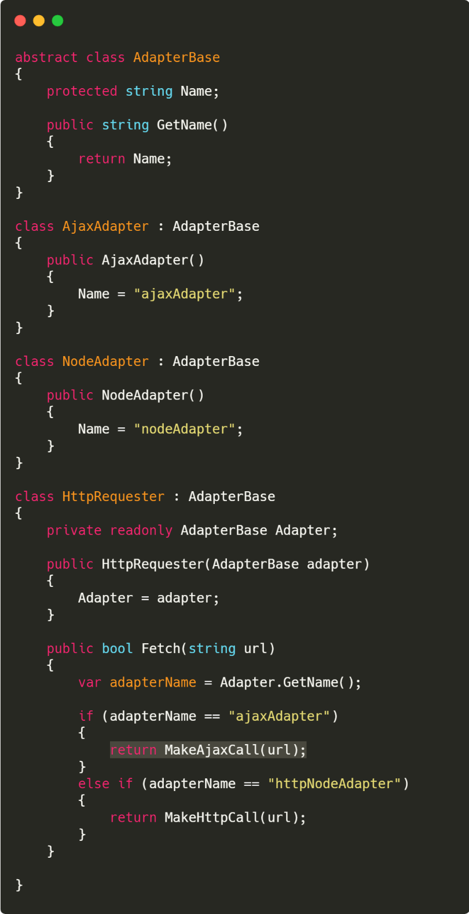
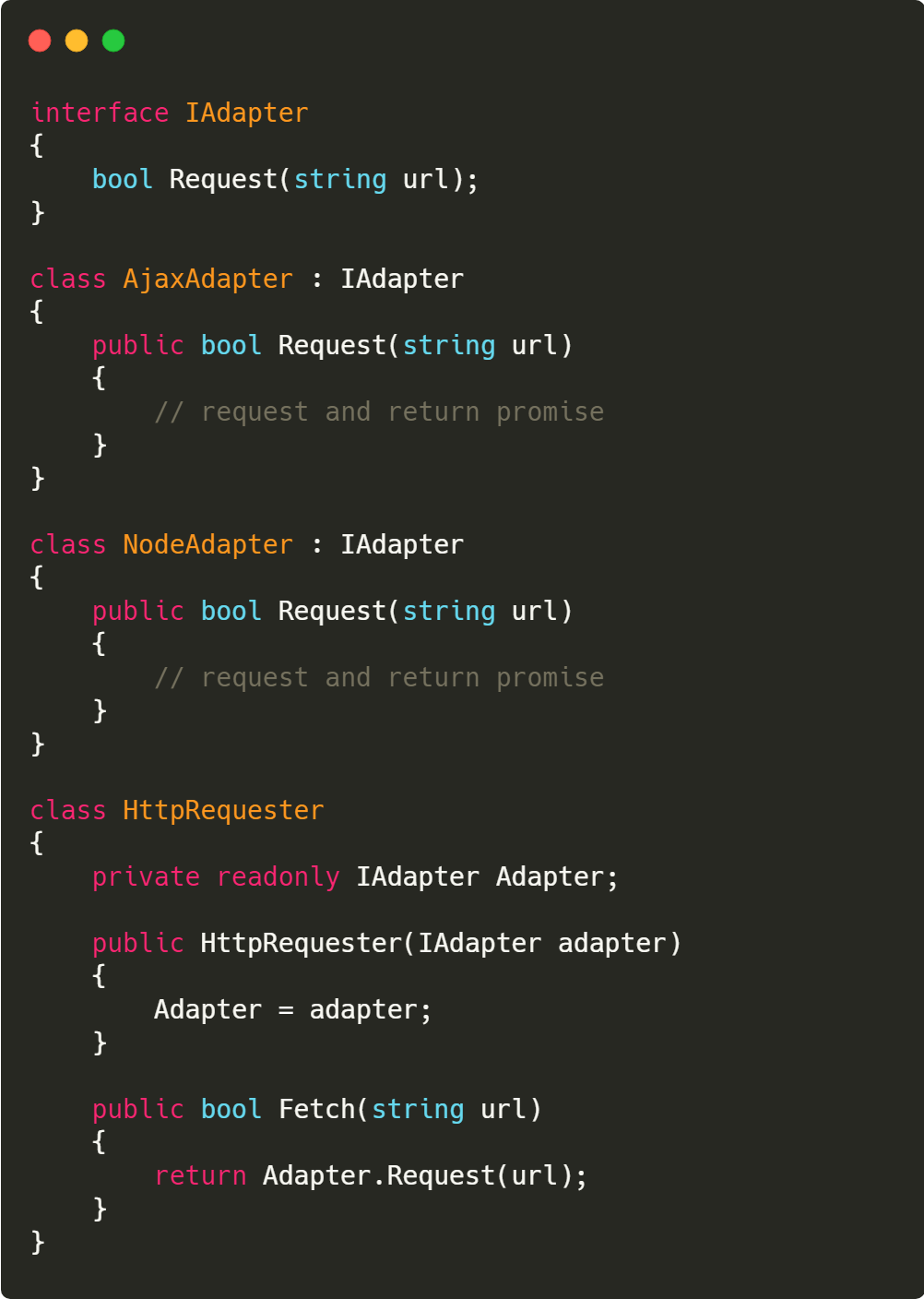
OCP
Bad:
Good:
Notes:
software entities (classes, modules, functions, etc.) should be open for extension, but closed for modification."

Slide 19
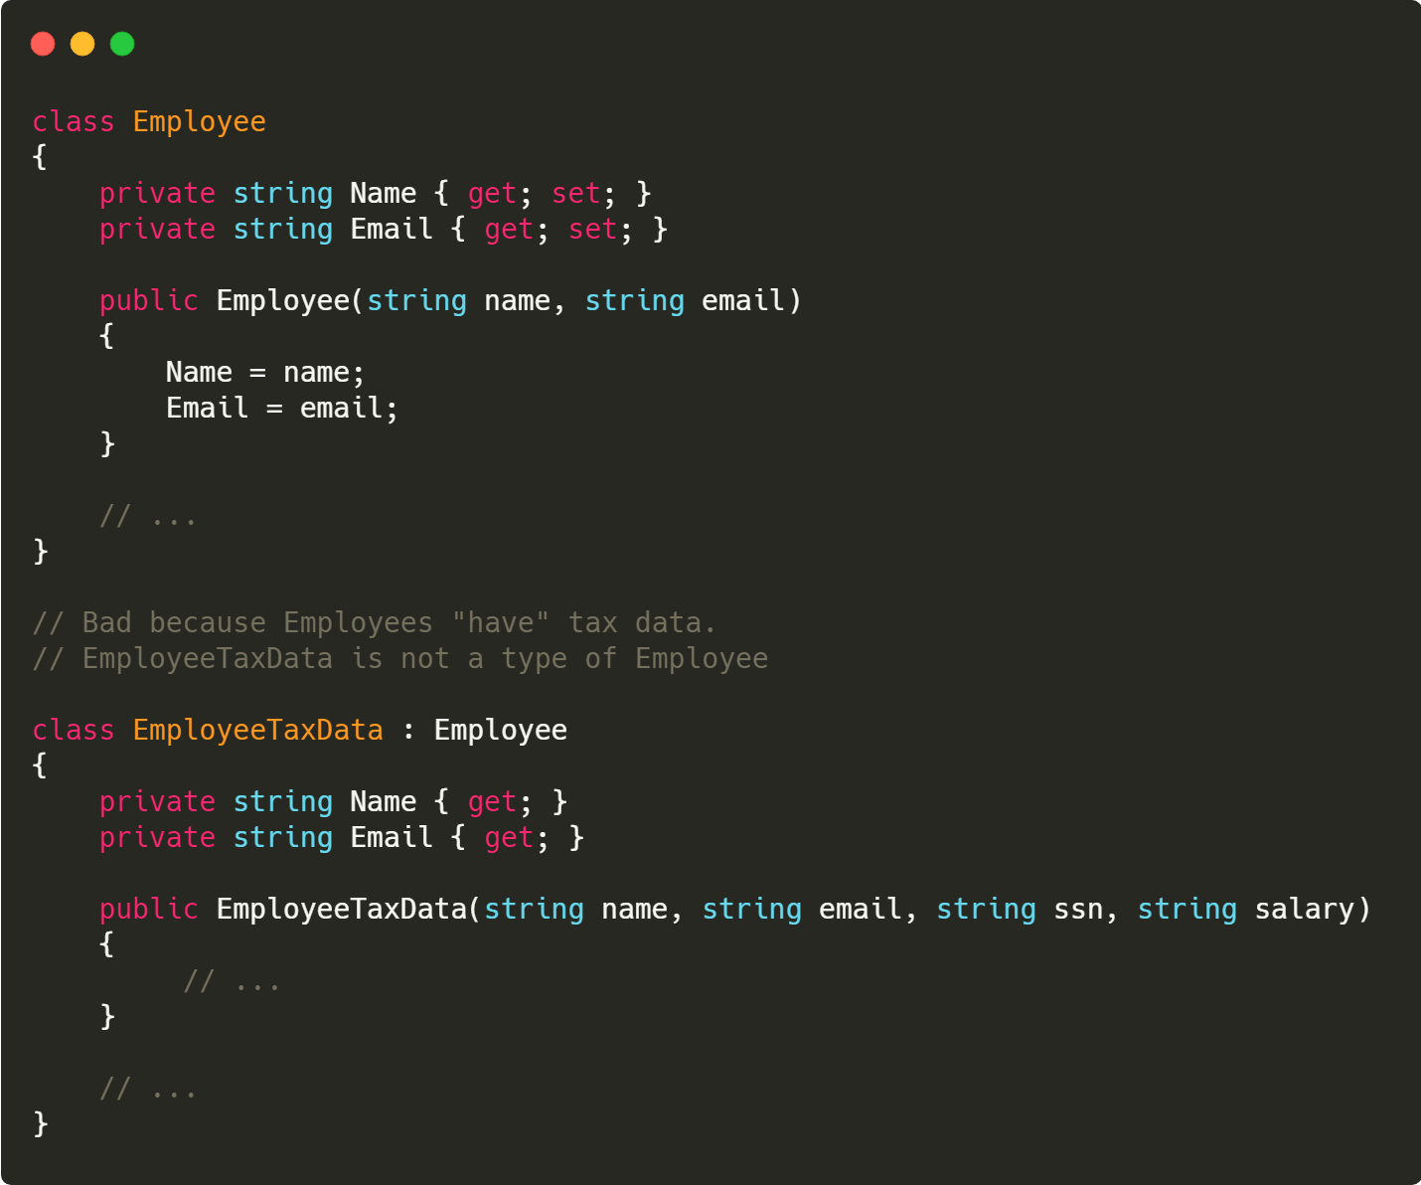
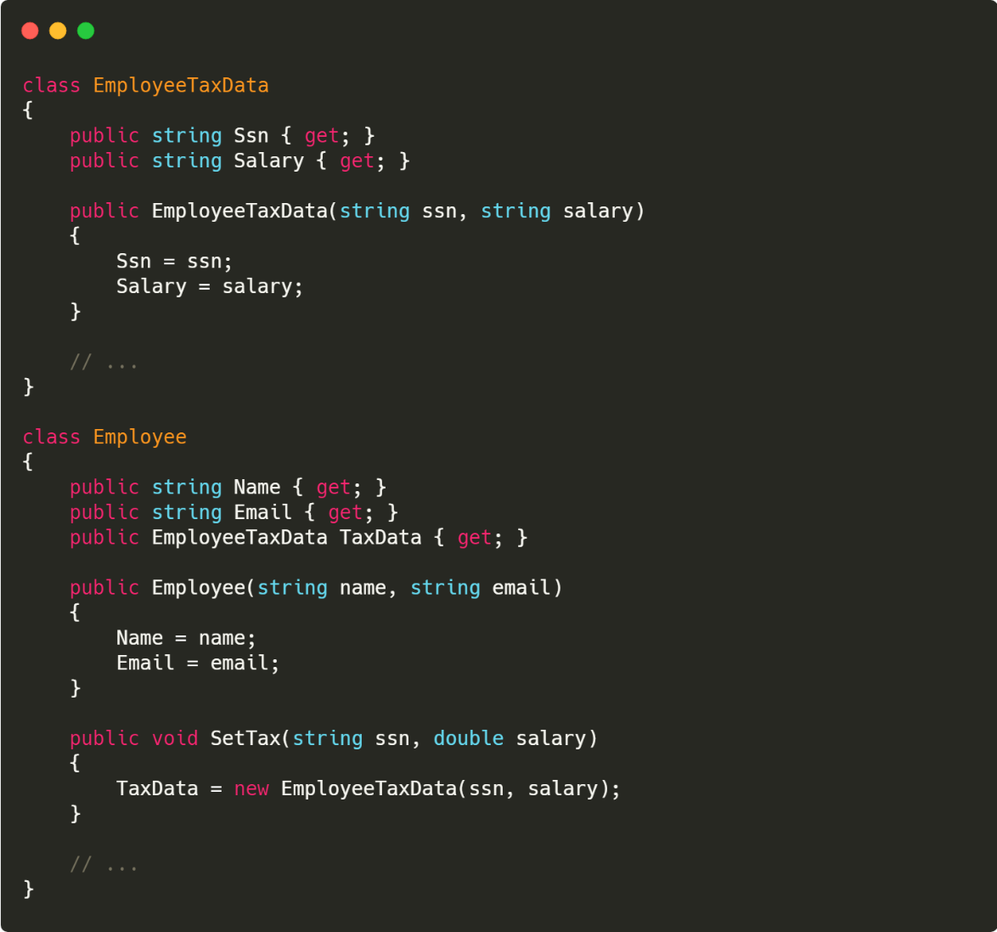
Composition over Inheritance
Bad:
Good:
Notes:
(Human->Animal vs. User->UserDetails).

Slide 20
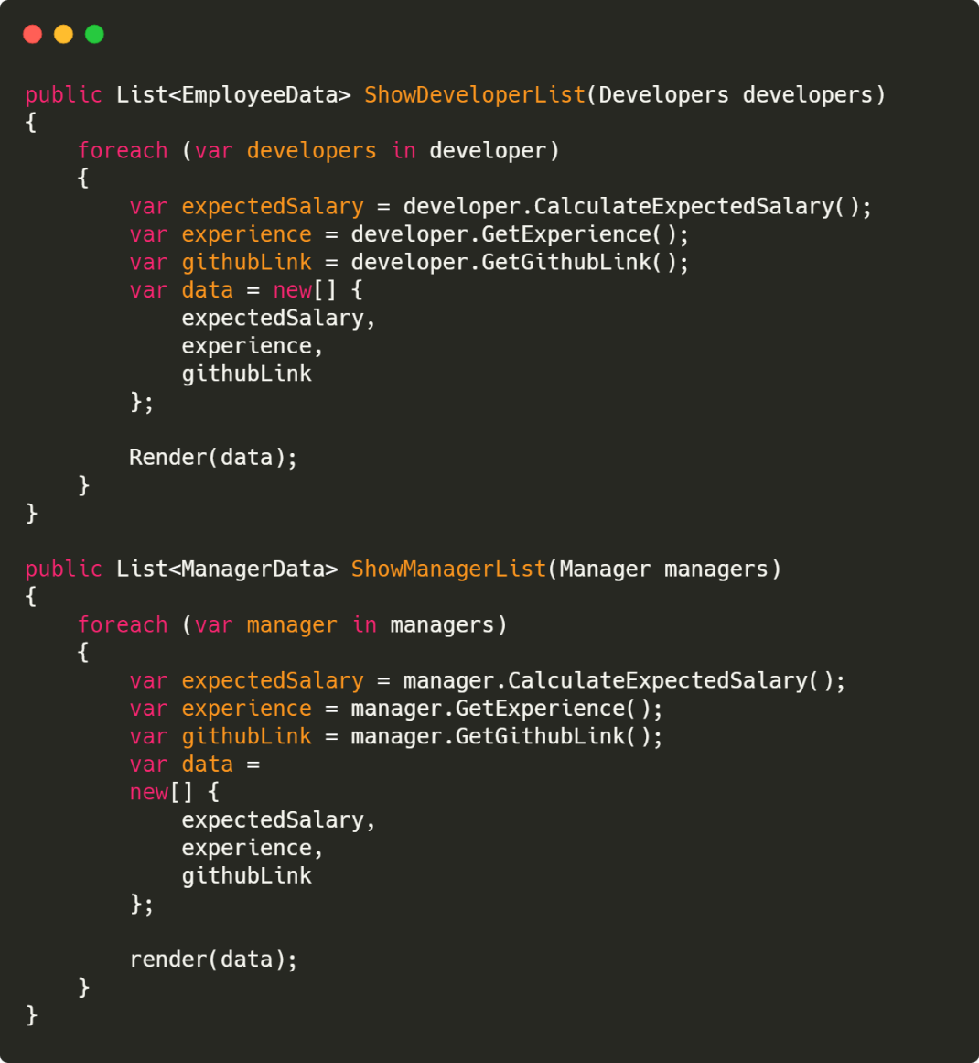
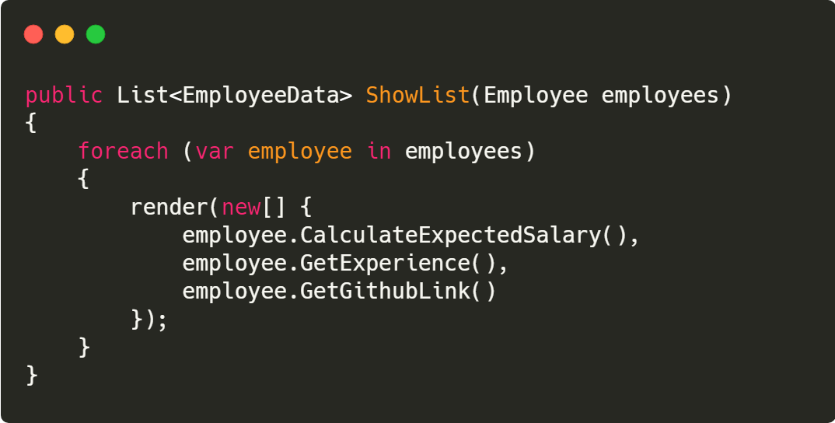
DRY
Bad:
Good:
Notes:
If any changes done, you have to change in multiple places

Slide 21
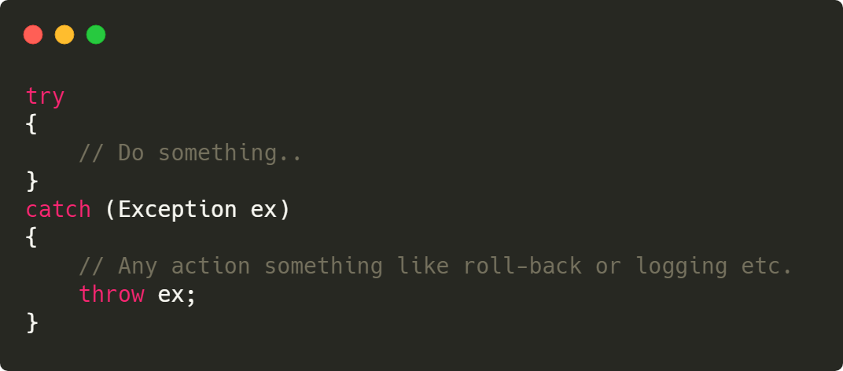

Don’t use throw ex
Bad:
Good:
Notes:
If any changes done, you have to change in multiple places

Slide 22
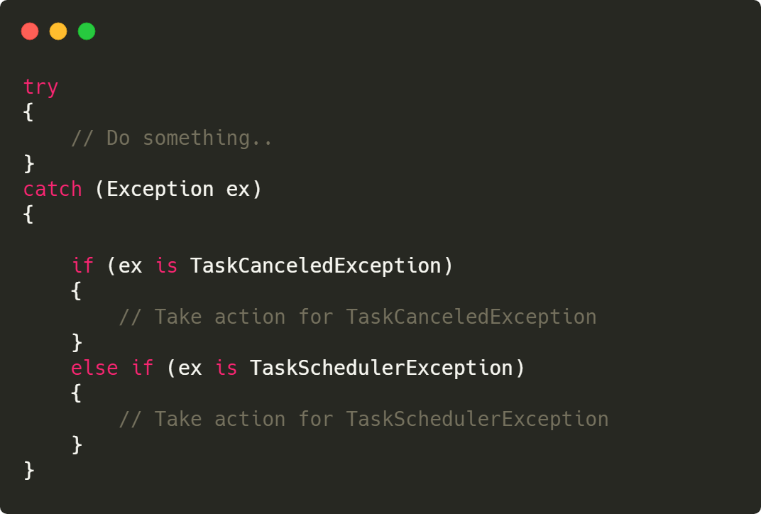
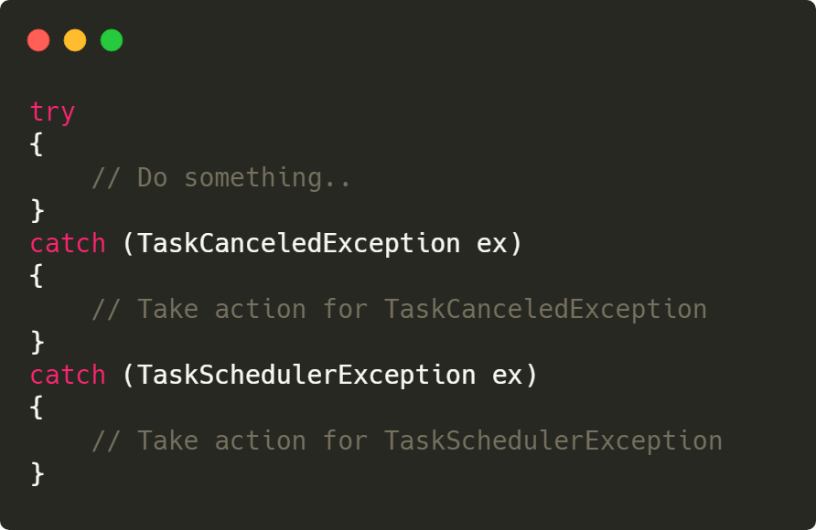
Use multi catch
Good:
Bad:
Notes:
If any changes done, you have to change in multiple places

Slide 23
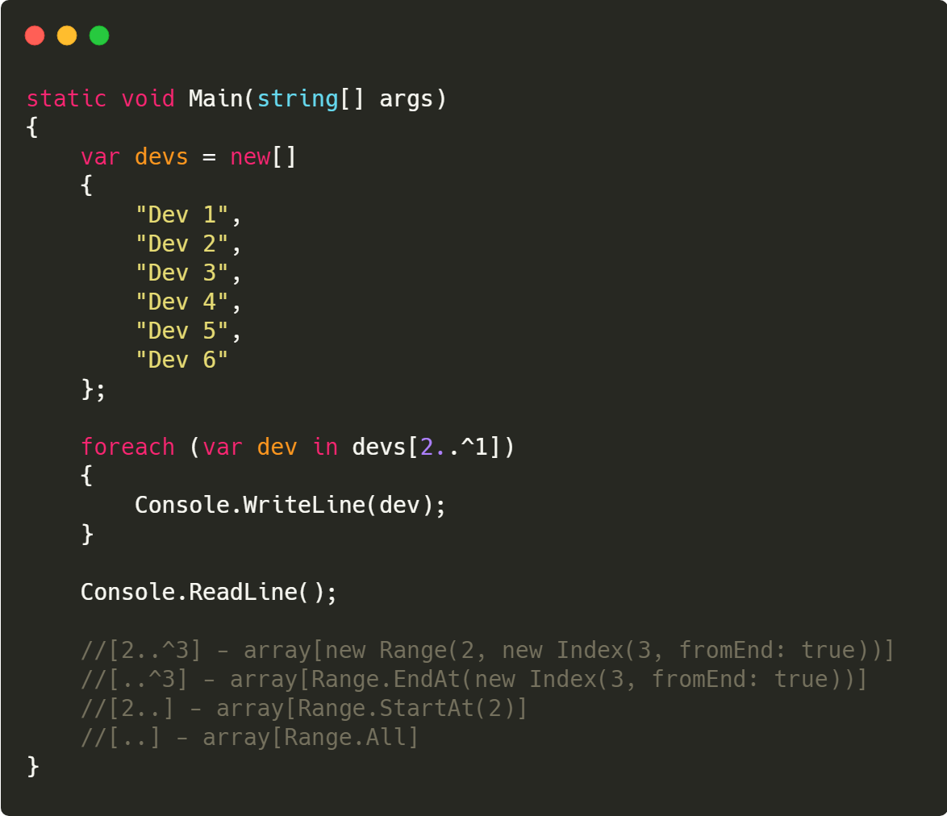
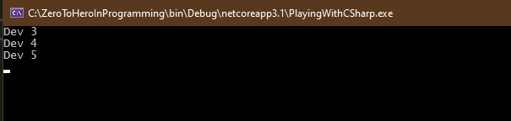
Ranges
Notes:
Makes you better developer

Slide 24



Thank you.
Logesh Palani
logesh.01@hotmail.com
@ logeshpalani32
@ logeshpalani32
@logeshpalani32

